Slide 1
PMG 4101: Project Management
Syed Samin Sadaf
Lecturer
Department of CSE,
United International University (UIU)

Slide 2
Project Planning
Vision, Scope, Risk Management

Slide 3
Understand the Project Needs
“AN URGENT NEED CAN BE A GOOD MOTIVATOR.”
Software is usually built to address an urgent need. It’s easy to build great software that solves the wrong problems, but the only way to build the appropriate software is for everyone in the project to understand and agree on both why and how that software will be built before the work begins.
That’s the purpose of project planning.
• Drive the Scope of the Project
• Talk to the Main Stakeholder
• Write the Vision and Scope Document following outline
• Review the vision and scope document

Slide 4
Vision Statement:
The Vision Statement is the first part of the documentation that
communicates:
the overall goal of the project
What it aims to achieve
Benefits
The “vision” part of the vision and scope document refers to a description of the goal of the software. All software is built to fulfill needs of certain users and stakeholders. The project manager must identify those needs and write down a vision statement (a general statement describing how those needs will be filled).
It describes the desired outcome and sets the direction for the
project. It is usually a high-level statement that conveys the essence
of the project.

Slide 5
Scope Statement:
• The Scope Statement defines the boundaries of the project, features
that will be developed, work that will be done to implement the
feature; outlining the deliverables and objectives. It describes what
will be included and excluded from the project, as well as the specific
requirements, timelines, and resources needed to achieve the goals.
• The Scope Statement helps to ensure that everyone involved in the
project understands the specific objectives and what is required to
achieve them. It often also includes an understanding of the features
that will be excluded from the project.

Slide 6
Create the Project Plan:
The project plan defines the work that will be done on the project and who will do it.
A typical project plan consists of:
• A statement of work that describes all work products that will be produced and
a list of people who will perform that work
• A resource list that contains a list of all resources that will be needed for the
product, and their availability
• A work breakdown structure and a set of effort estimates
• A project schedule
• A risk plan that identifies any risks that might be encountered and indicates
how those risks would be handled, should they occur

Slide 7
Risk Management

Slide 8
Risk Management
Risk analysis and management are actions that help a software team to understand and manage uncertainty.
A risk is a potential problem—it might happen, it might not. But, regardless of the outcome, it’s a really good idea to Identify it, assess its probability of occurrence, estimate its impact, and establish a contingency plan if the problem actually occur.

Slide 9
Risk Plan
A risk plan is a list of all risks that threaten the project, along with a plan to mitigate some or all of those risks. Each of the risks in the plan must be assessed by the project manager and the team.
Risk assessment is an important part of planning a software project because it allows the project manager to predict potential problems that will threaten the project and take steps to mitigate those problems.

Slide 10
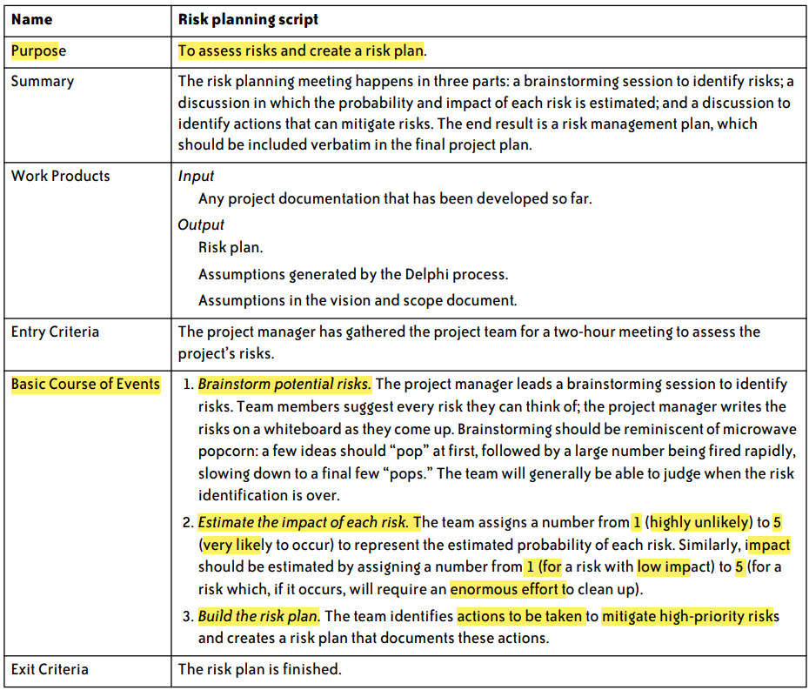
Risk Plan Script:

Slide 11
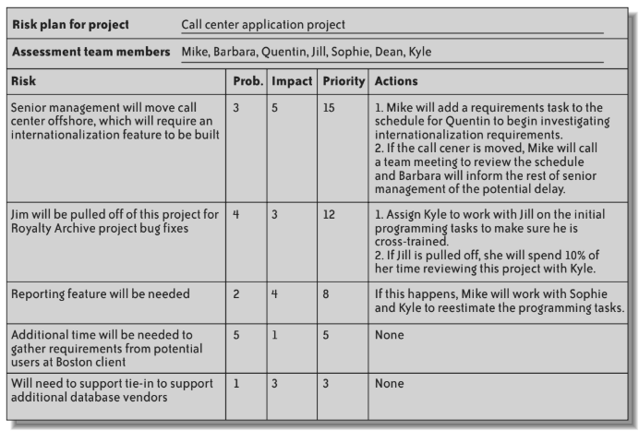
Sample Risk Plan:

Slide 12
RMMM
• Risk Mitigation, Monitoring, and Management (RMMM) plan is a structured approach to identifying, assessing, and managing risks in a project, program, or organization.
• It outlines the strategies and procedures for minimizing the impact of potential risks and monitoring and managing them throughout the project or program lifecycle

Slide 13
RMMM - Risk Mitigation
• Identify potential risks and their likelihood of occurring
• Determine the potential impact or consequence of each risk
• Develop a plan to minimize or avoid risks
• Implement risk mitigation strategies

Slide 14
RMMM - Risk Monitoring
• Continuously monitor for new risks
• Track progress of risk mitigation strategies
• Collect data and feedback from stakeholders
• Analysis data to identify trends or potential issues
• Communicate findings to relevant parties
• Take corrective action as necessary

Slide 15
RMMM - Risk Management
• Establish a risk management plan
• Allocate resources and responsibilities for risk management
• Identify and assess risks
• Develop strategies to manage risks
• Implement risk management strategies
•Monitor and review the effectiveness of risk management strategies

Slide 16
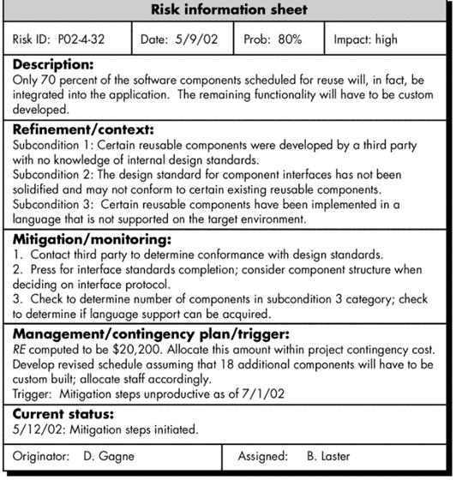
RMMM - Risk Information Sheet (RIS)

Slide 17
Any Questions?

Slide 18
Acknowledgement
Slide Courtesy:
Dr. Suman Ahmed, Professor, CSE Department, UIU

Slide 19
Thank You!

